Slide 1

William Stallings, Computer Organization and Architecture, 9th Edition
Chapter 11
Digital Logic
Notes:
Lecture slides prepared for “Computer Organization and Architecture”, 9/e, by William Stallings, Chapter 11 “Digital Logic”.
Adapted by Thân Văn Sử
The operation of the digital computer is based on the storage and processing of binary data. Throughout this book, we have assumed the existence of storage elements that can exist in one of two stable states and of circuits than can operate on binary data under the control of control signals to implement the various computer functions. In this chapter, we suggest how these storage elements and circuits can be implemented in digital logic, specifically with combinational and sequential circuits. The chapter begins with a brief review of Boolean algebra, which is the mathematical foundation of digital logic. Next, the concept of a gate is introduced. Finally, combinational and sequential circuits, which are constructed from gates, are described.

Slide 2
Objectives
What are the basis of digital circuits?
What are the basic electronic components?
How can minimize a combinational circuits?
After studying this chapter, you should be able to:
  Understand the basic operations of Boolean algebra.
  Use a Karnaugh map to simplify a Boolean expression.

Slide 3
Contents
11.1- Boolean Algebra
11.2-Gates
11.3- Combinational Circuit

Slide 4
11.1- Boolean Algebra
Mathematical discipline (môn) used to design and analyze the behavior of the digital circuitry in digital computers and other digital systems
Named after George Boole
  English mathematician
  Proposed basic principles of the algebra in 1854
  Claude Shannon suggested Boolean algebra could be used to solve problems in relay-switching circuit design
  Is a convenient tool:
  Analysis
    It is an economical way of describing the function of digital circuitry
  Design
    Given a desired function, Boolean algebra can be applied to develop a simplified implementation of that function
Notes:
2
The digital circuitry in digital computers and other digital systems is designed, and its behavior is analyzed, with the use of a mathematical discipline known as Boolean algebra. The name is in honor of an English mathematician George Boole, who proposed the basic principles of this algebra in 1854 in his treatise, An Investigation of the Laws of Thought on Which to Found the Mathematical Theories of Logic and Probabilities. In 1938, Claude Shannon, a research assistant in the Electrical Engineering Department at M.I.T., suggested that Boolean algebra could be used to solve problems in relay-switching circuit design [SHAN38]. Shannon’s techniques were subsequently used in the analysis and design of electronic digital circuits. Boolean algebra turns out to be a convenient tool in two areas:
• Analysis: It is an economical way of describing the function of digital circuitry.
• Design: Given a desired function, Boolean algebra can be applied to develop a simplified implementation of that function.

Slide 5


Boolean Algebra
Investigated Set:
B = { False, True } = { F, T} = {0,1}
Basic Operator: AND (.), OR (+), NOT
Other operators: NAND (Not And), NOR (Not Or), XOR ( Exclusive OR)
Representation:

Slide 6
Boolean Variables and Operations
Makes use of variables and operations
  Are logical
  A variable may take on the value 1 (TRUE) or 0 (FALSE)
  Basic logical operations are AND, OR, and NOT
  AND
  Yields true (binary value 1) if and only if both of its operands are true
  In the absence of parentheses the AND operation takes precedence over the OR operation
  When no ambiguity will occur the AND operation is represented by simple concatenation instead of the dot operator
  OR
  Yields true if either or both of its operands are true
  NOT
  Inverts the value of its operand
Notes:
3
As with any algebra, Boolean algebra makes use of variables and operations. In this case, the variables and operations are logical variables and operations. Thus, a variable may take on the value 1 (TRUE) or 0 (FALSE). The basic logical operations
are AND, OR, and NOT, which are symbolically represented by dot, plus sign, and overbar:
A AND B = A * B
A OR B = A + B
NOT A = Ā
The operation AND yields true (binary value 1) if and only if both of its operands are true. The operation OR yields true if either or both of its operands are true. The unary operation NOT inverts the value of its operand.
In the absence of parentheses, the AND operation takes precedence over the OR operation. Also, when no ambiguity will occur, the AND operation is represented by simple concatenation instead of the dot operator.

Slide 7
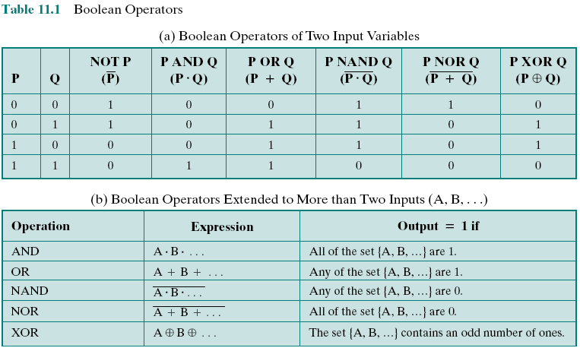
Table 11.1- Boolean Operators
Notes:
4

Slide 8
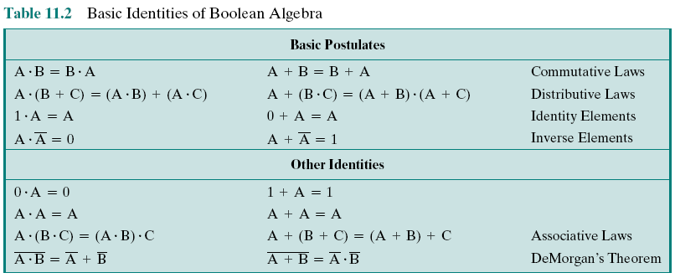
Table 11.2: Basic Identities of Boolean Algebra
Notes:
4

Slide 9
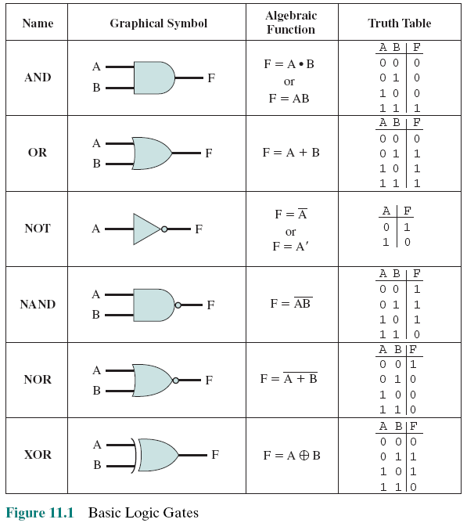
11.2- Basic Logic Gates
An electronic switch that is the elementary component of a digital circuit. It produces an electrical output signal that represents a binary 1 or 0 and is related to the states of one or more input signals by an operation of Boolean logic, such as AND, OR, or NOT
(Microsoft Computer Dictionary)
Notes:
The fundamental building block of all digital logic circuits is the gate. Logical functions are implemented by the interconnection of gates.
A gate is an electronic circuit that produces an output signal that is a simple Boolean operation on its input signals. The basic gates used in digital logic are AND, OR, NOT, NAND, NOR, and XOR. Figure 11.1 depicts these six gates. Each gate is defined in three ways: graphic symbol, algebraic notation, and truth table. The symbology used in this chapter is from the IEEE standard, IEEE Std 91. Note that the inversion (NOT) operation is indicated by a circle.
Each gate shown in Figure 11.1 has one or two inputs and one output. However, as indicated in Table 11.1b, all of the gates except NOT can have more than two inputs. Thus, (X + Y + Z) can be implemented with a single OR gate with three inputs. When one or more of the values at the input are changed, the correct output signal appears almost instantaneously, delayed only by the propagation time of signals through the gate (known as the gate delay). The significance of this delay is discussed in Section 11.3. In some cases, a gate is implemented with two outputs, one output being the negation of the other output.
Here we introduce a common term: we say that to assert a signal is to cause a signal line to make a transition from its logically false (0) state to its logically true (1) state. The true (1) state is either a high or low voltage state, depending on the type of electronic circuitry.
Typically, not all gate types are used in implementation. Design and fabrication are simpler if only one or two types of gates are used. Thus, it is important to identify functionally complete sets of gates. This means that any Boolean function can be implemented using only the gates in the set. The following are functionally complete sets:
AND, OR, NOT
AND, NOT
OR, NOT
NAND
NOR
It should be clear that AND, OR, and NOT gates constitute a functionally complete set, because they represent the three operations of Boolean algebra. For the AND and NOT gates to form a functionally complete set, there must be a way to synthesize the OR operation from the AND and NOT operations. This can be done by applying DeMorgan’s theorem.
Similarly, the OR and NOT operations are functionally complete because they can be used to synthesize the AND operation.

Slide 10
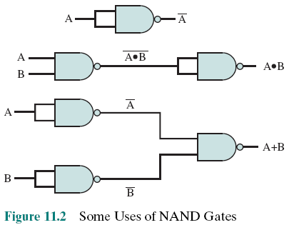
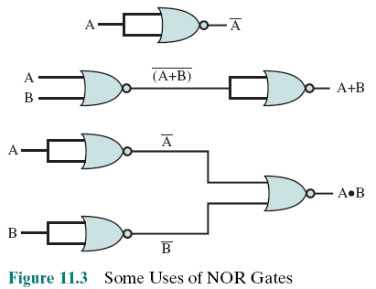
Uses of
NAND Gates
Uses of
NOR Gates
Notes:
Figure 11.2 shows how the AND, OR, and NOT functions can be implemented solely with NAND gates.
Figure 11.3 shows how the AND, OR, and NOT functions can be implemented solely with NOR gates.

Slide 11
11.3- Combinational
Circuit
An interconnected set of gates whose output at any time is a function only of the input at that time
The appearance of the input is followed almost immediately by the appearance of the output, with only gate delays
Consists of n binary inputs and m binary outputs
Can be defined in three ways:
Truth table
For each of the 2^{n} possible combinations of input signals, the binary value of each of the m output signals is listed
Graphical symbols
The interconnected layout of gates is depicted
Boolean equations
Each output signal is expressed as a Boolean function of its input signals
Notes:
A combinational circuit is an interconnected set of gates whose output at any time is a function only of the input at that time. As with a single gate, the appearance of the input is followed almost immediately by the appearance of the output, with only gate delays.
In general terms, a combinational circuit consists of n binary inputs and m binary outputs. As with a gate, a combinational circuit can be defined in three ways:
Truth table: For each of the 2n possible combinations of input signals, the binary value of each of the m output signals is listed.
Graphical symbols: The interconnected layout of gates is depicted.
Boolean equations: Each output signal is expressed as a Boolean function of
its input signals.

Slide 12
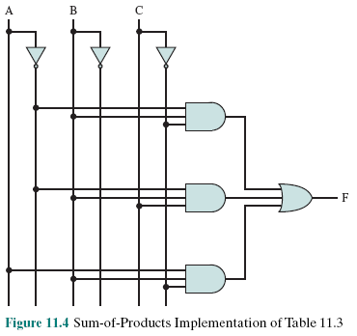
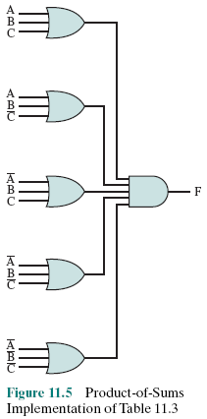
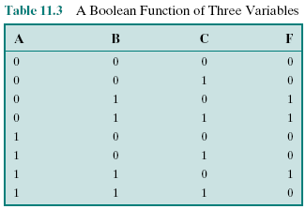
Example: Using 3 ways for a
Boolean Function of Three Variables
Sum of product (SOP)
Product of Sum (POS)
Notes:
Any Boolean function can be implemented in electronic form as a network of gates. For any given function, there are a number of alternative realizations. Consider the Boolean function represented by the truth table in Table 11.3.
There are three combinations of input values that cause F to be 1, and if any one of these combinations occurs, the result is 1. This form of expression, for self- evident reasons, is known as the sum of products (SOP) form.
Product of sums (POS) form, which is illustrated in Figure 11.5. For clarity, NOT gates are not shown. Rather, it is assumed that each input signal and its complement are available. This simplifies the logic diagram and makes the inputs to the gates more readily apparent.
Thus, a Boolean function can be realized in either SOP or POS form. At this point, it would seem that the choice would depend on whether the truth table contains more 1s or 0s for the output function: The SOP has one term for each 1, and the POS has one term for each 0. However, there are other considerations:
It is often possible to derive a simpler Boolean expression from the truth table than either SOP or POS
It may be preferable to implement the function with a single gate type (NAND or NOR)
The significance of the first point is that, with a simpler Boolean expression, fewer gates will be needed to implement the function. Three methods that can be used to achieve simplification are

Slide 13
Algebraic Simplication
Minimize a Boolean Function
A Boolean function will be implemented as a combinational network → More complex function will cause a more complex network
How to minimize a Bollean function?
  Methods:
    Karnaugh Map
    Quine-McCluskey Method

Slide 14
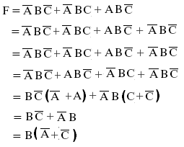
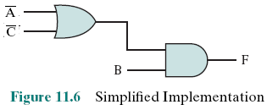
Algebraic Simplification
Notes:
Algebraic simplification involves the application of the identities of Table 11.2 to reduce the Boolean expression to one with fewer elements.
For example, consider again Equation (11.1).
This expression can be implemented as shown in Figure 11.6. The simplification of Equation (11.1) was done essentially by observation. For more complex expressions, some more systematic approach is needed.

Slide 15
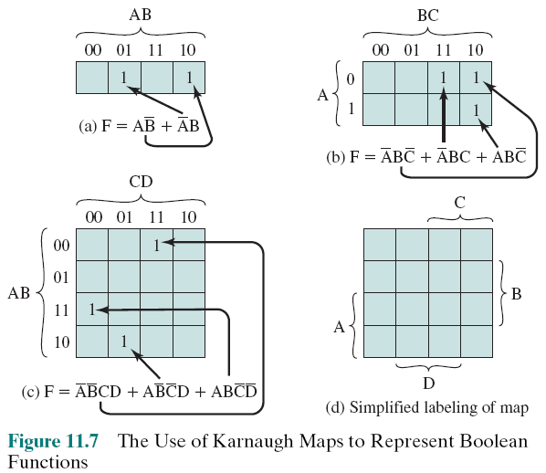
Karnaugh Map
A convenient way of representing a Boolean function of a small number (up to four) of variables
Notes:
For purposes of simplification, the Karnaugh map is a convenient way of representing a Boolean function of a small number (up to four) of variables. The map is an array of 2^{n} squares, representing all possible combinations of values of n binary variables. Figure 11.7a shows the map of four squares for a function of two variables. It is essential for later purposes to list the combinations in the order 00, 01, 11, 10. Because the squares corresponding to the combinations are to be used for recording information, the combinations are customarily written above the squares. In the case of three variables, the representation is an arrangement of eight squares (Figure 11.7b), with the values for one of the variables to the left and for the other two variables above the squares. For four variables, 16 squares are needed, with the arrangement indicated in Figure 11.7c.
The map can be used to represent any Boolean function in the following way. Each square corresponds to a unique product in the sum-of-products form, with a 1 value corresponding to the variable and a 0 value corresponding to the NOT of that variable. For each such product in the function, 1 is placed in the corresponding square. Given the truth table of a Boolean function, it is an easy matter to construct the map: for each combination of values of variables that produce a result of 1 in the truth table, fill in the corresponding square of the map with 1. Figure 11.7b shows the result for the truth table of Table 11.3. To convert from a Boolean expression to a map, it is first necessary to put the expression into what is referred to as canonical form: each term in the expression must contain each variable. So, for example, if we have Equation (11.3), we must first expand it into the full form of Equation (11.1) and then convert this to a map.
The labeling used in Figure 11.7d emphasizes the relationship between variables and the rows and columns of the map. Here the two rows embraced by the symbol A are those in which the variable A has the value 1; the rows not embraced by the symbol A are those in which A is 0; similarly for B, C, and D.

Slide 16
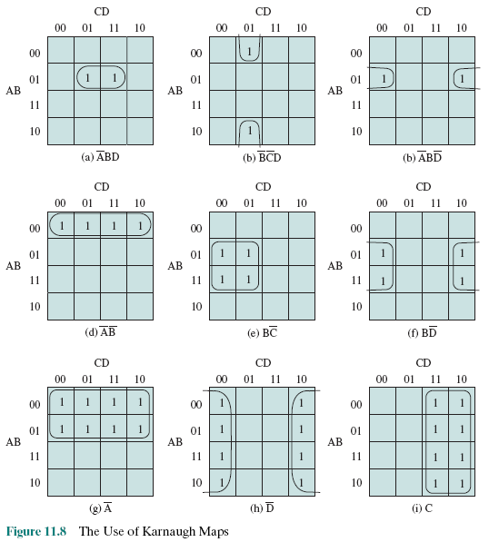
Example
Karnaugh
Maps
Notes:
Once the map of a function is created, we can often write a simple algebraic expression for it by noting the arrangement of the 1s on the map. The principle is as follows. Any two squares that are adjacent differ in only one of the variables. If two adjacent squares both have an entry of one, then the corresponding product terms differ in only one variable. In such a case, the two terms can be merged by eliminating that variable.
This process can be extended in several ways. First, the concept of adjacency can be extended to include wrapping around the edge of the map. Thus, the top square of a column is adjacent to the bottom square, and the leftmost square of a row is adjacent to the rightmost square. These conditions are illustrated in Figures 11.8b and c. Second, we can group not just 2 squares but 2^{n} adjacent squares (i.e., 2, 4, 8, etc.). The next three examples in Figure 11.8 show groupings of 4 squares. Note that in this case, two of the variables can be eliminated. The last three examples show groupings of 8 squares, which allow three variables to be eliminated.
We can summarize the rules for simplification as follows:
1. Among the marked squares (squares with a 1), find those that belong to a unique largest block of 1, 2, 4, or 8 and circle those blocks.
2. Select additional blocks of marked squares that are as large as possible and as few in number as possible, but include every marked square at least once. The results may not be unique in some cases. For example, if a marked square combines with exactly two other squares, and there is no fourth marked square to complete a larger group, then there is a choice to be made as two which of the two groupings to choose. When you are circling groups, you are allowed to use the same 1 value more than once.
3. Continue to draw loops around single marked squares, or pairs of adjacent marked squares, or groups of four, eight, and so on in such a way that every marked square belongs to at least one loop; then use as few of these blocks as possible to include all marked squares.

Slide 17
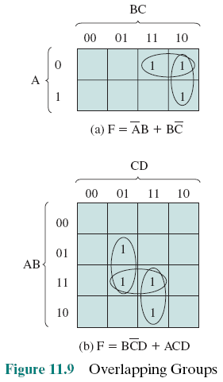
Overlapping
good
No good
Groups
Notes:
Figure 11.9a, based on Table 11.3, illustrates the simplification process. If any
isolated 1s remain after the groupings, then each of these is circled as a group of 1s.
Finally, before going from the map to a simplified Boolean expression, any group of 1s that is completely overlapped by other groups can be eliminated. This is shown in Figure 11.9b. In this case, the horizontal group is redundant and may be ignored in creating the Boolean expression.
One additional feature of Karnaugh maps needs to be mentioned. In some cases, certain combinations of values of variables never occur, and therefore the corresponding output never occurs. These are referred to as “don’t care” conditions. For each such condition, the letter “d” is entered into the corresponding square of the map. In doing the grouping and simplification, each “d” can be treated as a 1 or 0, whichever leads to the simplest expression.

Slide 18
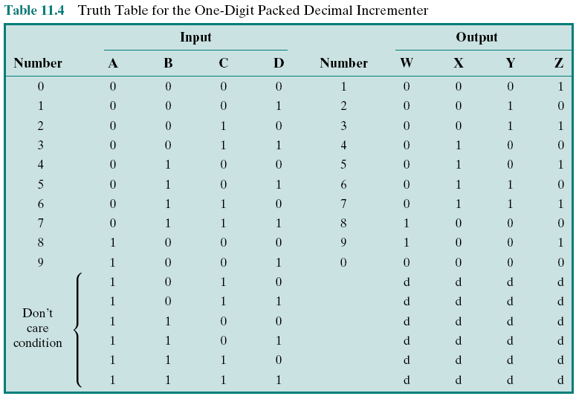
Table 11.4- Truth Table for the One-Digit Packed Decimal Incrementer
Notes:
Table 11.4 shows the truth table for producing a 4-bit result that is one more than a 4-bit BCD input. The addition is modulo 10. Thus, 9 + 1 = 0. Also, note that six of the input codes produce “don’t care” results, because those are not valid BCD inputs.

Slide 19
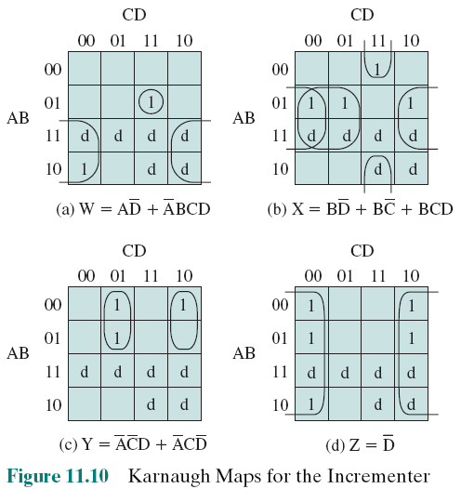
Figure
11.10
Notes:
Figure 11.10 shows the resulting Karnaugh maps for each of the output variables. The d squares are used to achieve the best possible groupings.

Slide 20
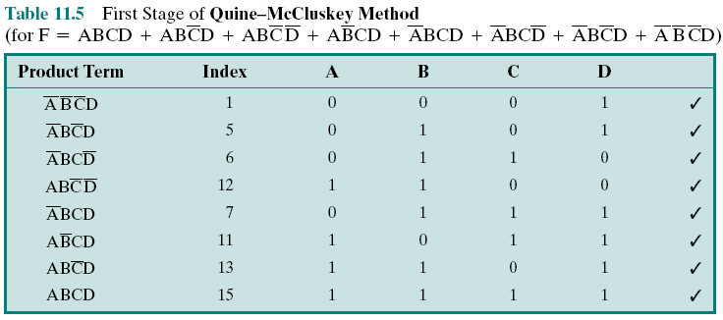
Table 11.5: First Stage of
Quine-McCluskey Method
0001
0101
0110
1100
0111
1011
1101
1111
A → 1, Not A → 0
ABCD → 1111 → Index=15
Notes:
For more than four variables, the Karnaugh map method becomes increasingly cumbersome. With five variables, two 16 * 16 maps are needed, with one map considered to be on top of the other in three dimensions to achieve adjacency. Six variables require the use of four 16 * 16 tables in four dimensions! An alternative approach is a tabular technique, referred to as the Quine–McCluskey method. The method is suitable for programming on a computer to give an automatic tool for producing minimized Boolean expressions.
The first step is to construct a table in which each row corresponds to one of the product terms of the expression. The terms are grouped according to the number of complemented variables. That is, we start with the term with no complements, if it exists, then all terms with one complement, and so on. Table 11.5 shows the list for our example expression, with horizontal lines used to indicate the grouping. For clarity, each term is represented by a 1 for each uncomplemented variable and a 0 for each complemented variable. Thus, we group terms according to the number of 1s they contain. The index column is simply the decimal equivalent and is useful in what follows.
The next step is to find all pairs of terms that differ in only one variable, that is, all pairs of terms that are the same except that one variable is 0 in one of the terms and 1 in the other. Because of the way in which we have grouped the terms, we can do this by starting with the first group and comparing each term of the first group with every term of the second group. Then compare each term of the second group with all of the terms of the third group, and so on. Whenever a match is found, place a check next to each term, combine the pair by eliminating the variable that differs in the two terms, and add that to a new list. This process continues until the entire original table has been examined.
The new table is organized into groups, as indicated, in the same fashion as the first table. The second table is then processed in the same manner as the first. That is, terms that differ in only one variable are checked and a new term produced for a third table. In this example, the third table that is produced contains only one term: BD.
In general, the process would proceed through successive tables until a table with no matches was produced. In this case, this has involved three tables.

Slide 21
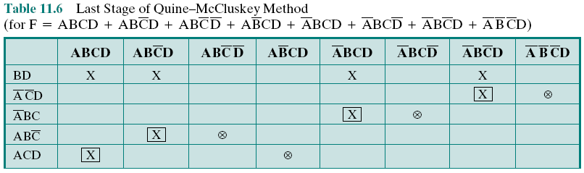
Table 11.6: Last Stage of
Quine-McCluskey Method
1111 + 1101 → 11-1
0111 + 0101 → 01-1
11-1+ 01-1 → -1-1 → BD
Notes:
Once the process just described is completed, we have eliminated many of the possible terms of the expression. Those terms that have not been eliminated are used to construct a matrix, as illustrated in Table 11.6. Each row of the matrix corresponds to one of the terms that have not been eliminated (has no check) in any of the tables used so far. Each column corresponds to one of the terms in the original expression. An X is placed at each intersection of a row and a column such that the row element is “compatible” with the column element. That is, the variables present in the row element have the same value as the variables present in the column element. Next, circle each X that is alone in a column. Then place a square around each X in any row in which there is a circled X. If every column now has either a squared or a circled X, then we are done, and those row elements whose Xs have been marked constitute the minimal expression.
In cases in which some columns have neither a circle nor a square, additional processing is required. Essentially, we keep adding row elements until all columns are covered.

Slide 22
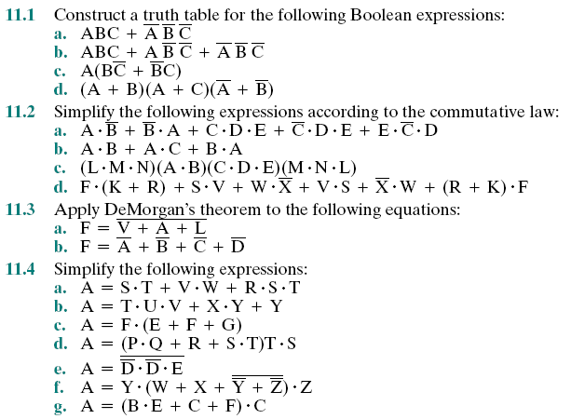
Exercises

Slide 23
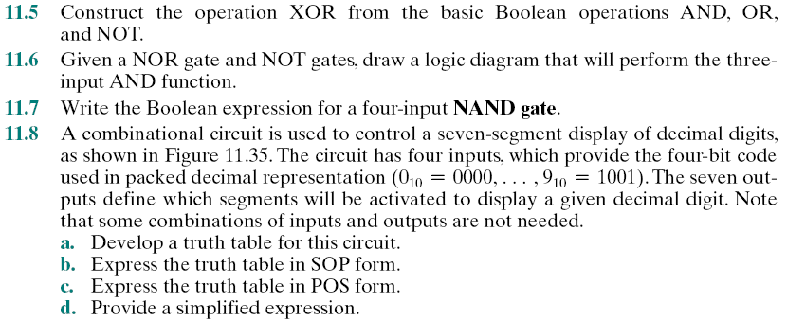
Summary

Slide 24
Summary
Digital Logic
Chapter 11
Boolean Algebra
Gates
Combinational Circuit
  Algebraic Simplification
    Karnaugh Map
    Quine-McCluskey Method
Notes:
Chapter 9 summary.

Slide 25
